Slide 1
Web Engineering
Lecture 3
3-Tier Architecture
Zulfiqar Ahmad
Lecturer
Department of Information Technology
Hazara University Mansehra
zulfiqarahmad@hu.edu.pk

Slide 2
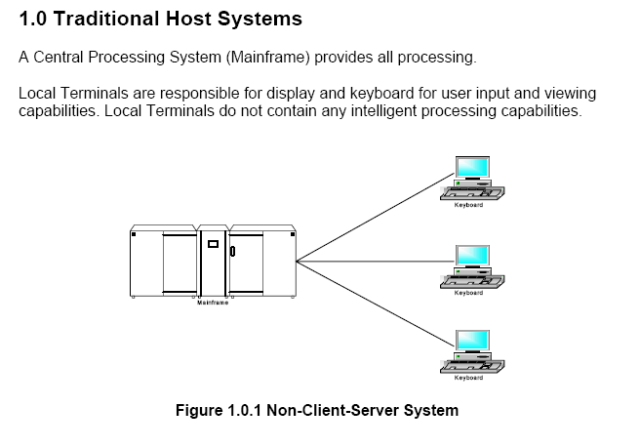

Slide 3
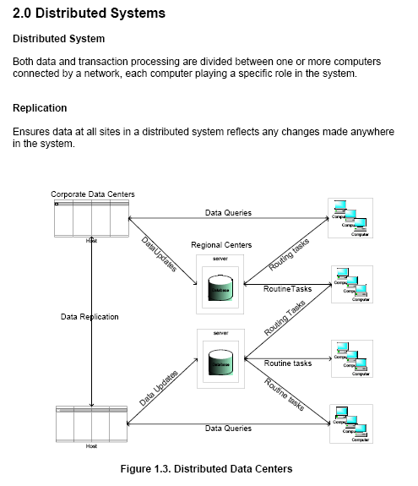

Slide 4
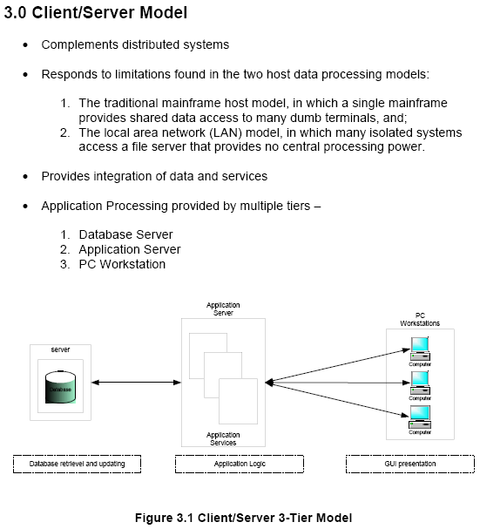

Slide 5
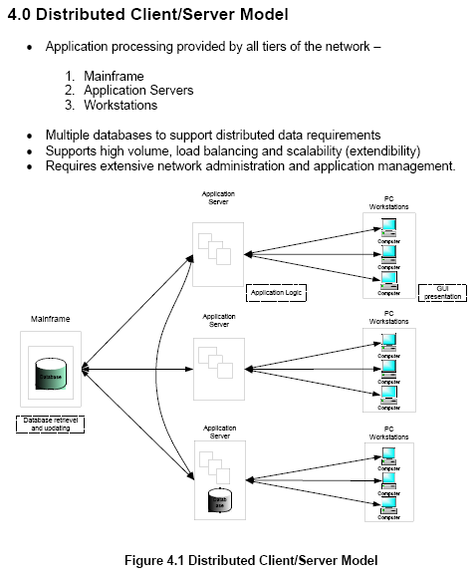

Slide 6
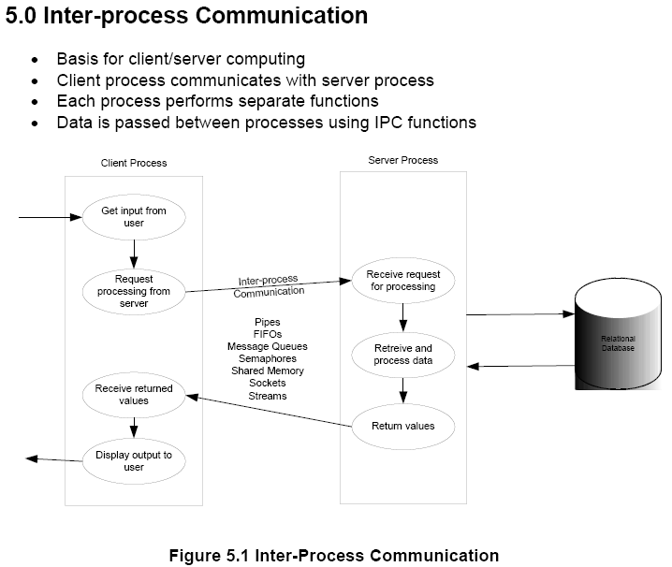

Slide 7
